Slide 1
Web and mobile app development – csc3054/7054
6.1 SQLite database

Slide 2
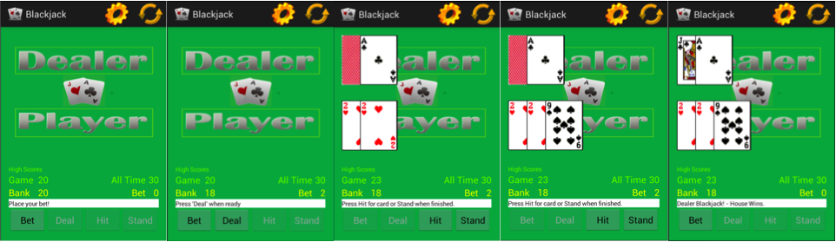
“blackjack” application
This is the standard blackjack game where the player is to beat the dealer with a hand that has a higher value than his but does not exceed the value 21.

Slide 3
What we discussed in the last lecture?
SQLite concepts
SQLite architecture
Started creating a SQLite project

Slide 4
Questions to be answered
What is the role of the CommentsDataSource class in the project?
How to create, delete, get or cursor to comments in the CommentsDataSource class?
What is the role of MainActivity in the project?
How to add or delete comments in MainActivity?
How to formulate activity_main.xml?

Slide 5
Content outline
Building up a project of SQLite
Summary
Next lecture
Further readings

Slide 6
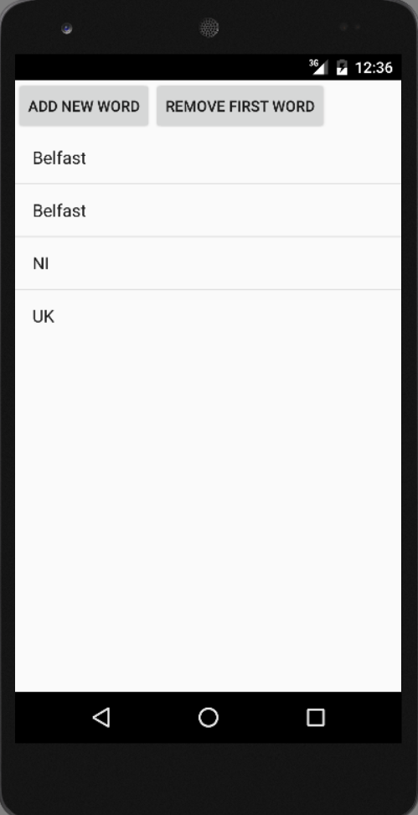
Application display

Slide 7
design
MySQLiteHelper.java
To create a table for the database.
Comment.java
To create a data model to hold the data and show in the user interface.
CommentsDataSource.java
To maintain the database and add/fetch comments.
MainActivity.java
To use a ListActivity/ListView to display the data.
To connect to data source.
To show a list of items.

Slide 8
Commentsdatasource class
This class is a data access object (DAO).
This class maintains the database connection and supports adding new comments and fetching all comments.

Slide 9
Commentsdatasource class
public Comment createComment(String comment) {
ContentValues values = new ContentValues();
values.put(MySQLiteHelper.COLUMN_COMMENT, comment);
long insertId = database.insert(MySQLiteHelper.TABLE_COMMENTS, null, values);
Cursor cursor = database.query(MySQLiteHelper.TABLE_COMMENTS, allColumns, MySQLiteHelper.COLUMN_ID + " = " + insertId, null, null, null, null);
cursor.moveToFirst();
Comment newComment = cursorToComment(cursor);
cursor.close();
return newComment; }

Slide 10
Code explanations
Line 5: Returns results are cursor object. (1) Table name, (2) Table columns, (3) where clause, …
Line 6: Point to the first element object or cursor object or cursor is not empty.
Line 7: Call another method to go through the cursor and perform whatever logic coded inside the method.
Line 9: Return the comment object to caller.

Slide 11
Commentsdatasource class
public void deleteComment(Comment comment) {
long id = comment.getId();
System.out.println("Comment deleted with id: " + id);
database.delete(MySQLiteHelper.TABLE_COMMENTS, MySQLiteHelper.COLUMN_ID + " = " + id, null);
}

Slide 12
Commentsdatasource class
public List<Comment> getAllComments() {
List<Comment> comments = new ArrayList<Comment>();
Cursor cursor = database.query(MySQLiteHelper.TABLE_COMMENTS, allColumns, null, null, null, null, null);
cursor.moveToFirst();
while (!cursor.isAfterLast()) { Comment comment = cursorToComment(cursor);
comments.add(comment); cursor.moveToNext();
}
// make sure to close the cursor
cursor.close();
return comments; }

Slide 13
Commentsdatasource class
private Comment cursorToComment(Cursor cursor) {
Comment comment = new Comment();
comment.setId(cursor.getLong(0));
comment.setComment(cursor.getString(1));
return comment;
}

Slide 14
mainactivity class
Use a ListActivity to display the data.
ListActivity is a subclass of Activity that included a ListView object.
We can create an activity in the application that is connected to data sources (e.g. query cursor or array).
Show a set of list items on the screen.

Slide 15
mainactivity class
public void onCreate(Bundle savedInstanceState) {
super.onCreate(savedInstanceState);
setContentView(R.layout.activity_main);
datasource = new CommentsDataSource(this);
datasource.open();
List<Comment> values = datasource.getAllComments();
//use the SimpleCursorAdapter to show the
//elements in a ListView
ArrayAdapter<Comment> adapter = new ArrayAdapter<Comment>(this, android.R.layout.simple_list_item_1, values);
setListAdapter(adapter); }

Slide 16
Code explanations
Line 4: allow comments to be made and saved in ‘datasource’.
Line 6: use ‘values’ to hold all the comments stored in ‘datasource’.
Line 9: an ArrayAdapter is used to convert an ArrayList of objects into View items loaded into the ListViewcontainer. This line of code is to initialise the adapter and attach the adapter to the ListView. ‘android.R.layout.simple_list_item_1’ – a row layout in the res/layout folder which contains the corresponding design for a row in ListView.

Slide 17
mainactivity class
// Will be called via the onClick attribute of the buttons in activity_main.xml when a View is pressed
public void onClick(View view) {
@SuppressWarnings("unchecked")
ArrayAdapter<Comment> adapter = (ArrayAdapter<Comment>) getListAdapter();
Comment comment = null;
switch (view.getId()) {
case R.id.add:
String[] comments = new String[] { “UK", “NI", “Belfast" };
int nextInt = new Random().nextInt(3);

Slide 18
Code explanations
Line 3: allows Java programmers to disable compilation warnings for a certain part of a program (type, field, method, parameter, constructor, and local variable).
Line 4: get the ListActivity associated with its ListView.
Line 6: which View is pressed.
Line7: if an ‘add’ button is pressed.
Line 9: choose an integer smaller than 3.

Slide 19
mainactivity class
//save the new comment to the database
comment = datasource.createComment(comments[nextInt]);
Comment = new Comment();
Comment.setComment(coments[nextInt]);
adapter.add(comment);
break;
case R.id.delete:
if (getListAdapter().getCount() > 0) {
comment = (Comment) getListAdapter().getItem(0);
datasource.deleteComment(comment);
adapter.remove(comment); }
break; }
adapter.notifyDataSetChanged(); }

Slide 20
Code explanations
Line 5: add ‘comment’ to the adapter.
Line 7: in case ‘delete’ button is chosen.
Line 8: in case ListAdapter contains data, not empty.
Line 9: pick up the zeroth item of the adapter.
Line 10: delete ‘comment’ from the database.
Line 11: remove ‘comment’ from the adapter.

Slide 21
Activity_main.xml
<LinearLayout
android:id="@+id/group"
android:layout_width="wrap_content"
android:layout_height="wrap_content" >
<Button
android:id="@+id/add"
android:layout_width="wrap_content"
android:layout_height="wrap_content"
android:text="Add New Word"
android:onClick="onClick"/>

Slide 22
Activity_main.xml
<Button
android:id="@+id/delete"
android:layout_width="wrap_content" android:layout_height="wrap_content"
android:text="Delete First Word"
android:onClick="onClick"/>
</LinearLayout>
<ListView
android:id="@android:id/list"
android:layout_width="match_parent"
android:layout_height="wrap_content"
android:text="@string/hello" />

Slide 23
Content outline
Building up a project of SQLite
Summary
Next lecture
Further readings

Slide 24
Summary
CommentsDataSource class – role and code.
MainActivity class – role and code.
Activity_main.xml for the layout of the project.

Slide 25
Content outline
Building up a project of SQLite
Summary
Next lecture
Further readings

Slide 26
next lecture
To introduce a Google Map application.

Slide 27
Content outline
Building up a project of SQLite
Summary
Next lecture
Further readings

Slide 28
Further readings
http://developer.android.com/training/index.html
Android Application Development for Dummies, Donn Felker, Wiley Publishing, Inc., NJ, 2011.

